Slide 1









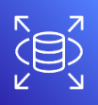

Redis Session
1. 파일 저장
1
POST /files
[MultipartFile]
2
PUT Object
DEPLOY
File Serivce
Bucket
Distribution
3
fileUrl
: https://distributionURI/objectKey
Users
4
POST /resources
{… fileUrl}
Service A
Redis Cache
JPA
JDBC
Postgres A DB

Slide 2
Redis Session
2. 파일 삭제
1
2
Check Exists
DELETE /files/{objectKey]
PURGE
File Serivce
Bucket
Distribution
4
200 OK
3
Delete Object
Users
5
DELETE /resources/{id}
Service A
Redis Cache
JPA
JDBC
Postgres A DB

Slide 3


Redis Session
3. 파일 조회 – public access
GET
https://distributionURI/objectKey
Amazon
Route 53
Contents
image/ video / file
Caching
DEPLOY
Users
Edge location
Distribution
Bucket

Slide 4


Redis Session
3. 파일 조회 – signed url
4
GET https://distributionURI?expires&signature&key-pair-id
Amazon
Route 53
Contents
image/ video / file
Caching
DEPLOY
Users
Edge location
Distribution
Bucket
1
GET /signed-url?distibutionId&objectKey
GET SignedURL
2
signedUrl
: https://distributionURI?expires&signature&key-pair-id
File Serivce
Amazon IAM
3

Slide 5


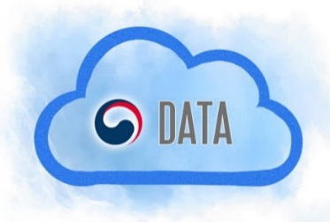









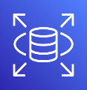
Redis Session
메시지큐 서버
AWS 추가계정 2
HTML5
Auth App
React
SPA A
REST
오픈데이터 포털
PUT/DELETE
File Serivce
React
SPA C
XML/JSON
HTML
/JS/CSS
NginX
React
SPA B
메시지큐 서버
AWS 추가계정 2
IMAGE
/FILE
Service A
Redis Cache
Distribution
Bucket
JPA
JDBC
A 팀원 계정
Postgres A DB
AJAX
Eureka Service Registry
ROUTING
RabbitMQ
Users
REST
DISCOVER
Service B
Redis Cache
EVENT
B 팀원 계정
MESSAGE
QUEUE
Spring Cloud Gatway
JPA
JDBC
게이트웨이 서버
AWS 추가계정 1
Postgres B DB
AuthFilter
Redis Session
Service C
Redis Cache
JPA
JDBC
JPA
JDBC
C 팀원 계정
Postgres Auth DB
Postgres C DB

